Slide 1
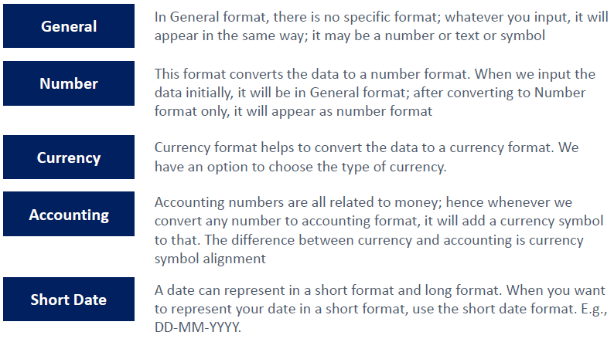
Types of Formats
Types of Formats

Slide 2
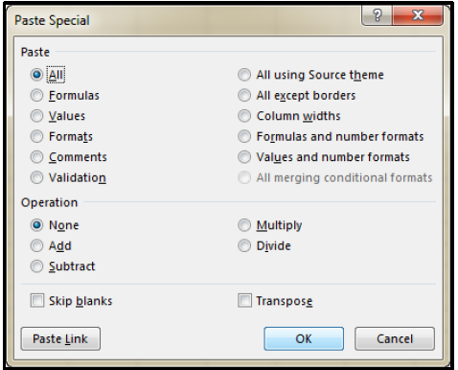
Paste Special
In situations where a standard copy / paste is
not appropriate, Excel's Paste Special offers a wide
range of options to paste only specific elements of the
copied cells or perform a mathematical
operation with the copied data
Click

Slide 3
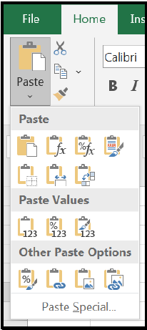
Paste Special
Paste special in excel means when we want to paste only
some aspects of the data rather than the original data we use this
option, there are various methods to paste special in excel, and they
are by right click on the target cell and select paste special or by
keyboard shortcut as CTRL + ALT + V or we can press ALT + E + S, to
use the aspects we can use the Excel shortcut of paste values we
can press ALT + E + S + V for values only.

Slide 4

EXCEL INTERFACE
File Menu

Slide 5

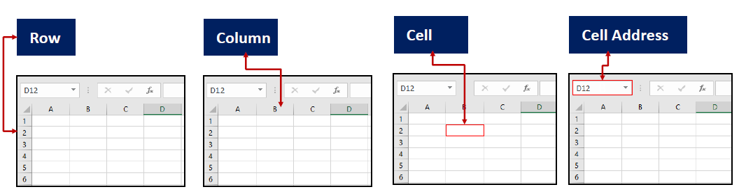

Slide 6
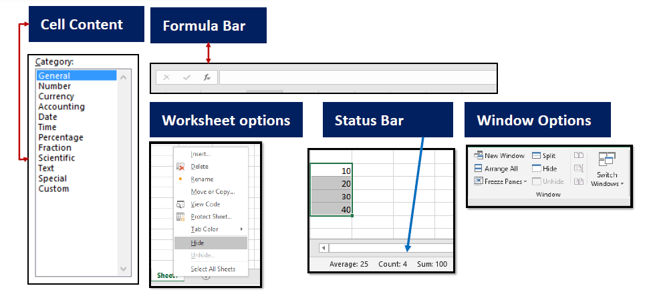
EXCEL INTERFACE

Slide 7
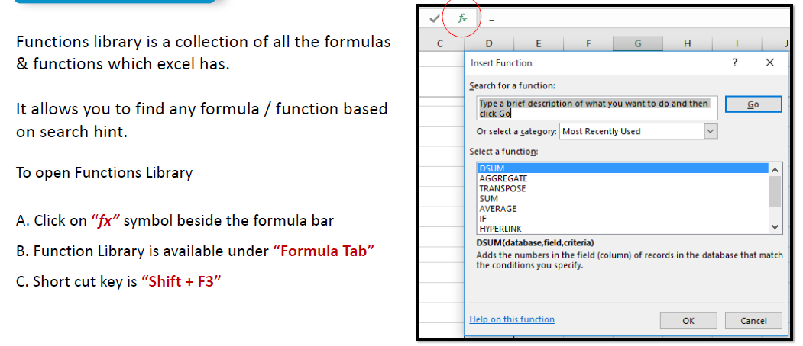
Functions Library

Slide 8
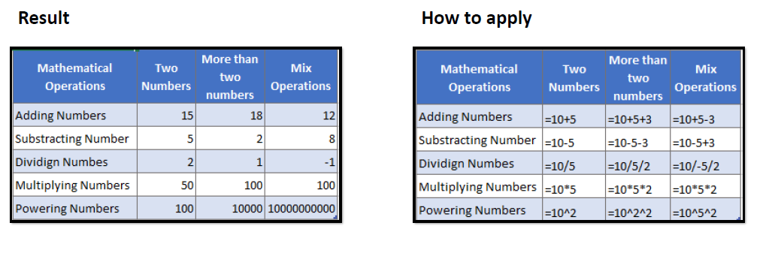
BASIC FORMULAS & FUNCTIONS

Slide 9
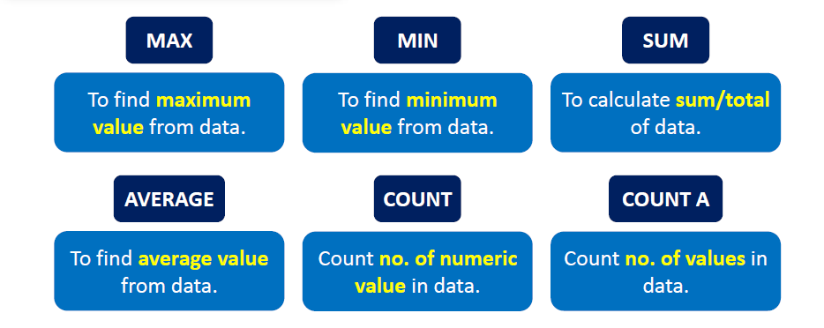
Basic Formulas - Numbers

Slide 10
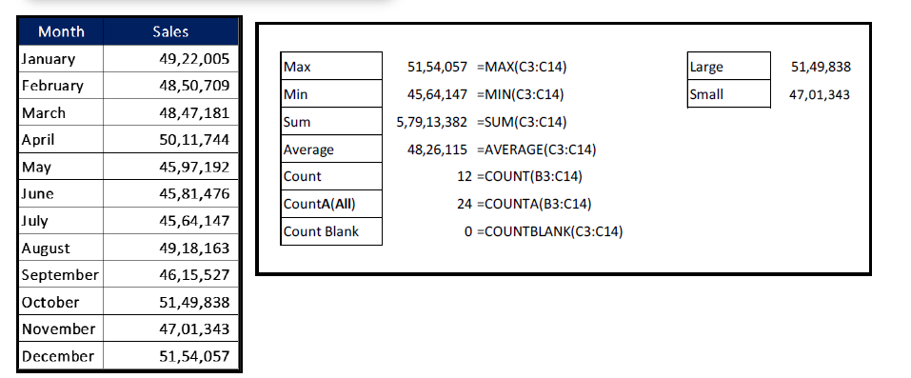
Basic Formulas - Numbers

Slide 11
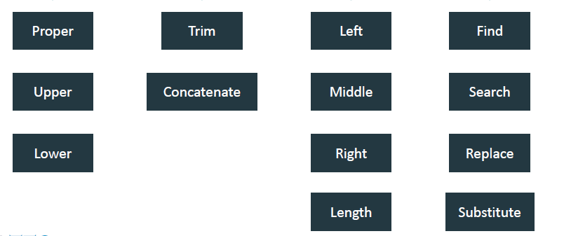
Basic Formulas – Text Functions

Slide 12
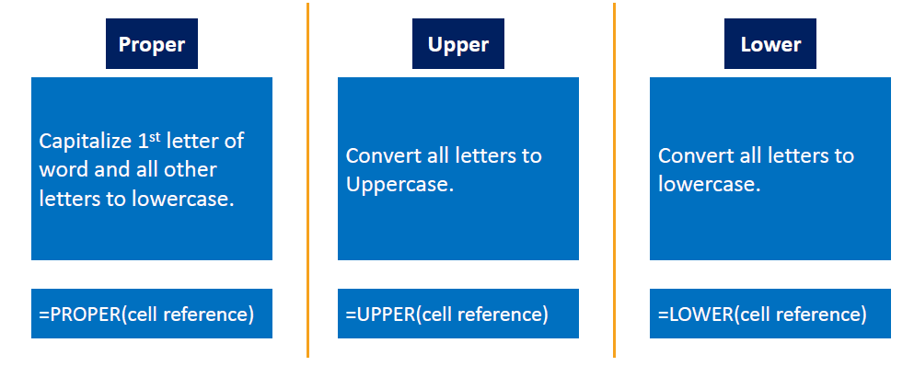
Basic Formulas - Text

Slide 13
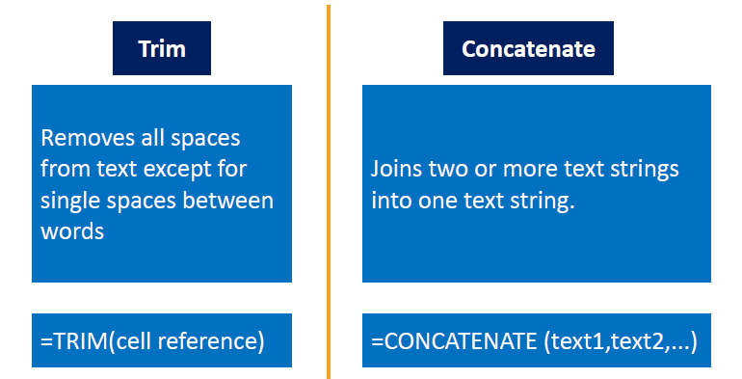
Basic Formulas - Text

Slide 14
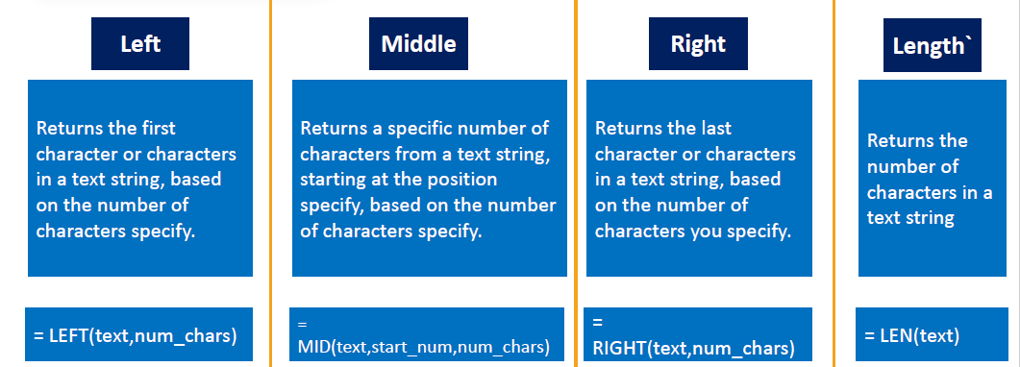
Basic Formulas - Text

Slide 15
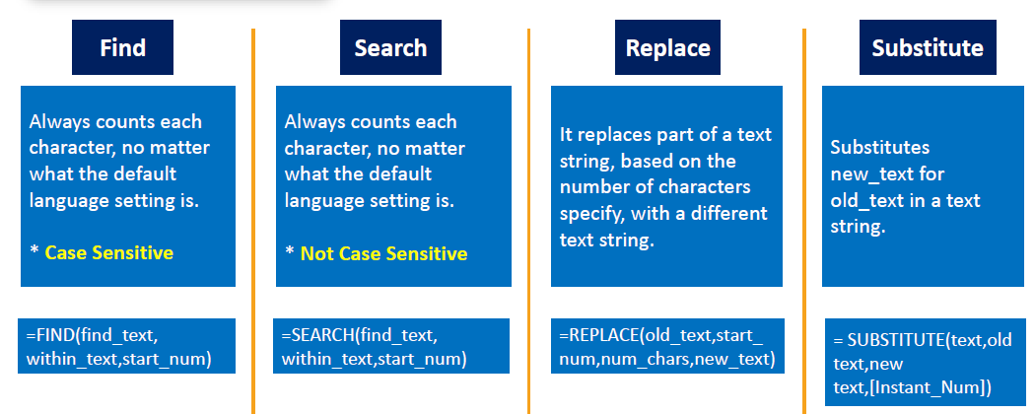
Basic Formulas - Text

Slide 16
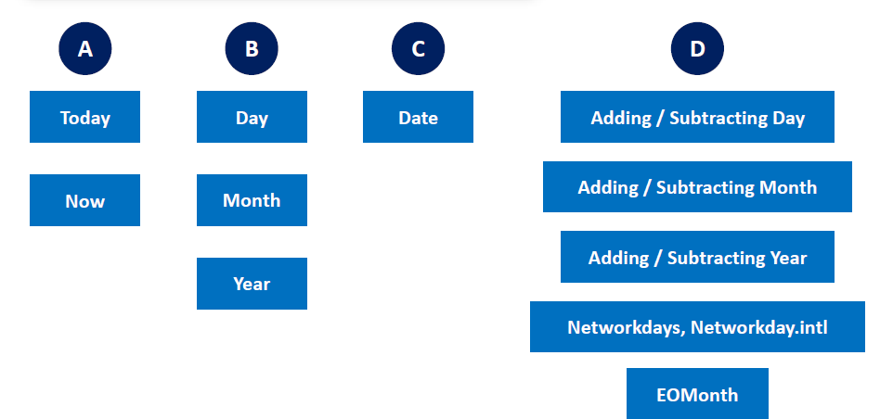
DATE & TIME FUNCTIONS

